Slide 1
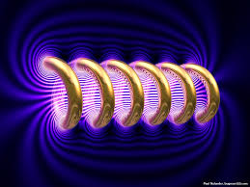
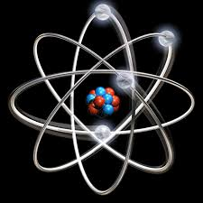

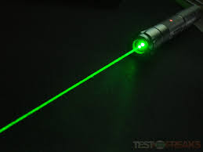
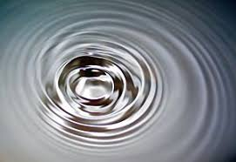

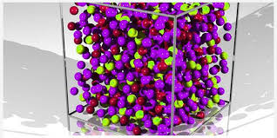
Engineering Physics
PHY-109
LASER-2
ELECTROMAGNETIC THEORY
QUANTUM MECHANICS
LASER
WAVES
Dr. Vishal Thakur
Department of Physics
Lovely Professional University
Phagwara, Punjab-144411
SOLID STATE PHYSICS
FIBER OPTICS

Slide 2
Syllabus
Fundamentals of laser- energy levels in atoms
Radiation matter interaction, Absorption of light
Spontaneous emission of light, stimulated emission of light
Population of energy levels, Einstein A and B coefficients
Metastable state, population inversion, lasing action
Properties of laser, resonant cavity, excitation mechanisms
Nd - YAG, He-Ne Laser, Semiconductor Laser
Applications of laser in engineering, holography.

Slide 3

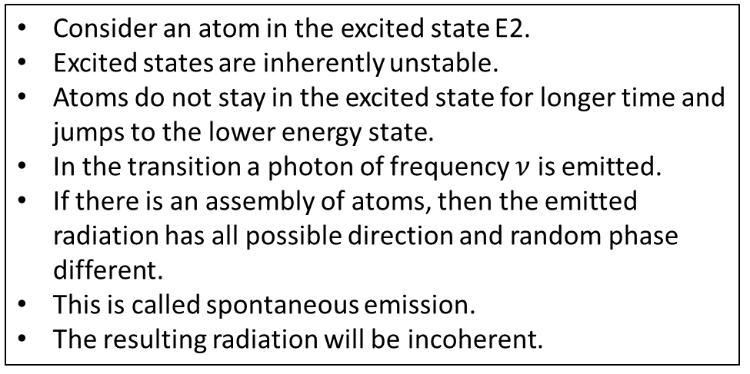


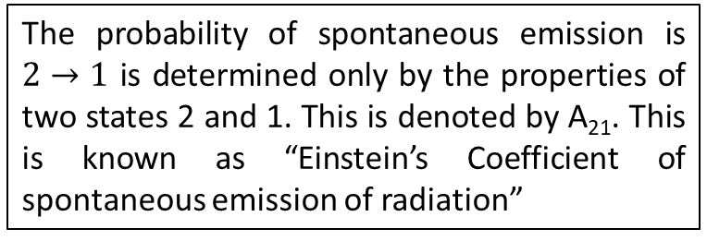
Spontaneous Emission of Light
Consider an atom in the excited state E2.
Excited states are inherently unstable.
Atoms do not stay in the excited state for longer time and jumps to the lower energy state.
In the transition a photon of frequency $ν$ is emitted.
If there is an assembly of atoms, then the emitted radiation has all possible direction and random phase different.
This is called spontaneous emission.
The resulting radiation will be incoherent.
$$E_{2}$$
$$hν$$
$$E_{1}$$
Spontaneous emission is ultimately responsible for most of the light we see all around us. If atoms (or molecules) are excited by some means other than heating, the spontaneous emission is called luminescence. For example, fireflies are luminescent.
The probability of spontaneous emission is $2→1$ is determined only by the properties of two states 2 and 1. This is denoted by A₂₁. This is known as “Einstein’s Coefficient of spontaneous emission of radiation”

Slide 4




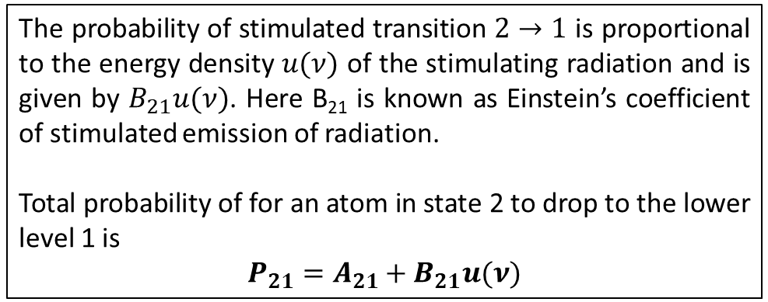

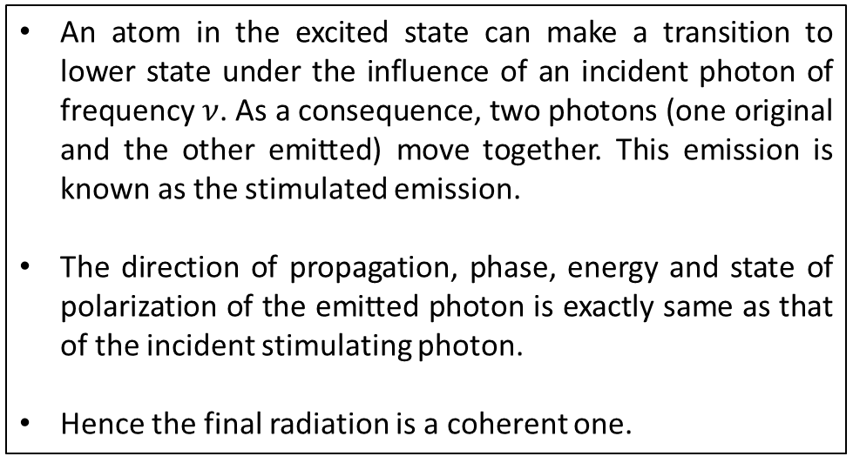
Stimulated Emission of Light
Before
An atom in the excited state can make a transition to lower state under the influence of an incident photon of frequency $ν$. As a consequence, two photons (one original and the other emitted) move together. This emission is known as the stimulated emission.
The direction of propagation, phase, energy and state of polarization of the emitted photon is exactly same as that of the incident stimulating photon.
Hence the final radiation is a coherent one.
$$E_{2}$$
$$hν$$
$$E_{1}$$
After
$$E_{2}$$
$$hν$$
The probability of stimulated transition $2→1$ is proportional to the energy density $u(ν)$ of the stimulating radiation and is given by $B_{21}u(ν)$. Here B₂₁ is known as Einstein’s coefficient of stimulated emission of radiation.
Total probability of for an atom in state 2 to drop to the lower level 1 is
$$P_{21}=A_{21}+B_{21}u(ν)$$
$$hν$$
$$E_{1}$$

Slide 5
Distinction between stimulated and spontaneous emission
SL No. | Spontaneous Emission | Stimulated Emission
1. | Not controllable from outside | Controllable from outside
2. | The emitted photons during the process of spontaneous emission have different direction of propagation, initial phase and plane of polarization. | The incident photon and emitted photon propagate in the same direction. They have same phase, frequency and plane of polarization.
3. | The light (radiation) is not monochromatic and incoherent. | The light is coherent and monochromatic.
4. | The light has no preferred direction and light spreads in all direction around the source. The intensity decreases rapidly with distance from the source. | The light is unidirectional and intensity remains almost the same with distance.

Slide 6
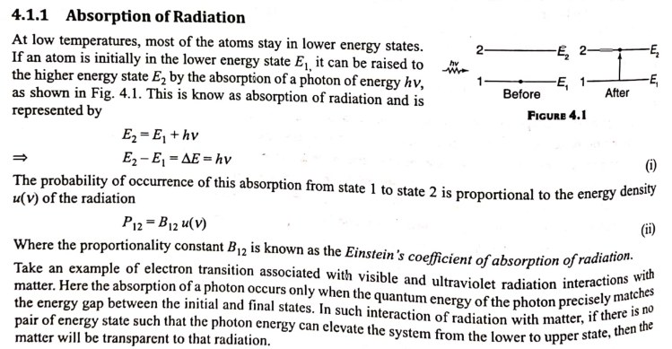

Slide 7
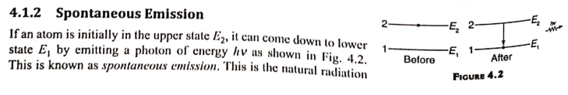
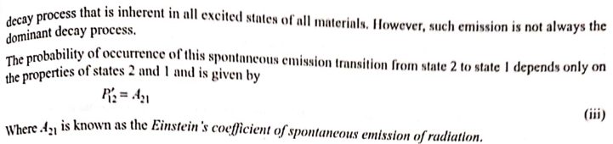

Slide 8
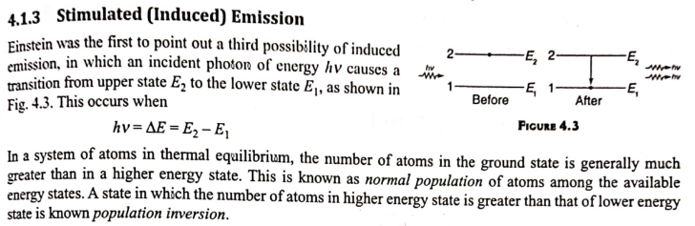
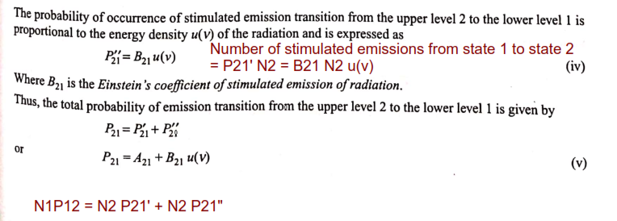

Slide 9
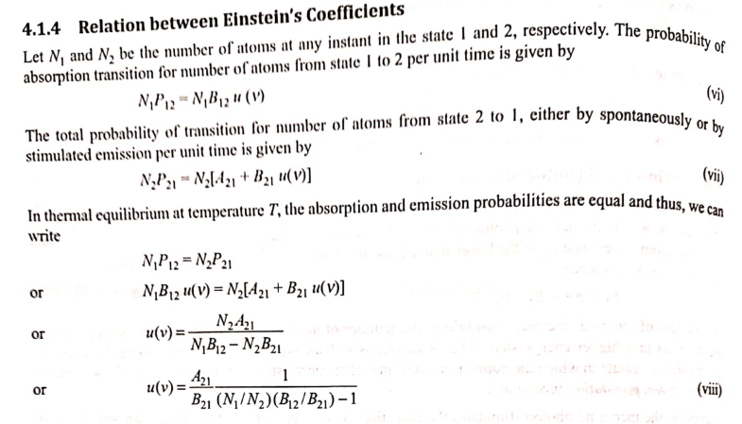

Slide 10
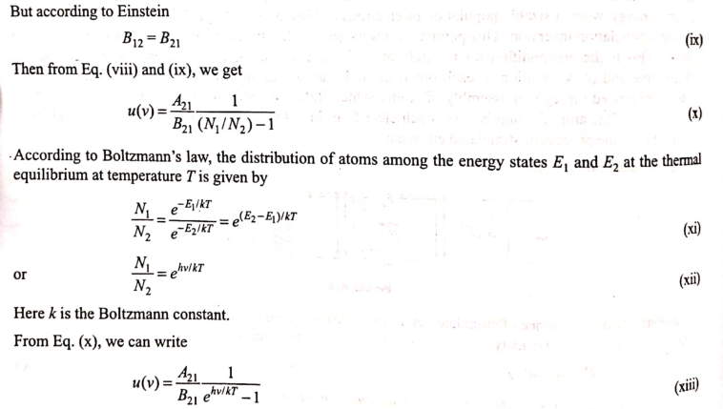

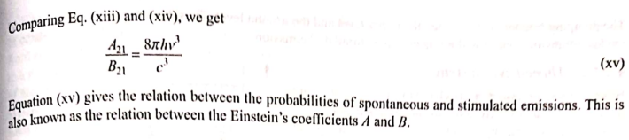

Slide 11
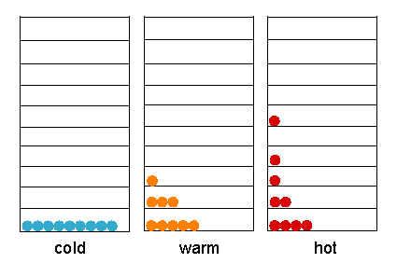
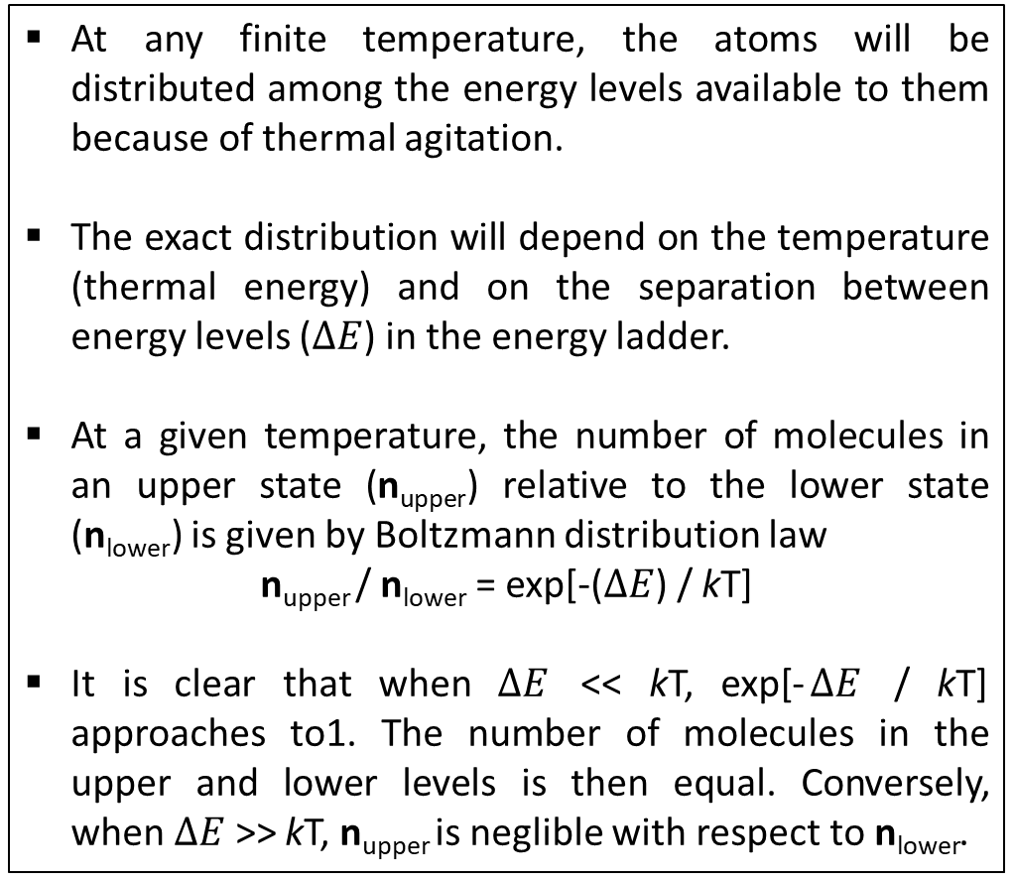
Population of Energy Levels
At any finite temperature, the atoms will be distributed among the energy levels available to them because of thermal agitation.
The exact distribution will depend on the temperature (thermal energy) and on the separation between energy levels ($ΔE$) in the energy ladder.
At a given temperature, the number of molecules in an upper state (n_{upper}) relative to the lower state (n_{lower}) is given by Boltzmann distribution law
n_{upper} / n_{lower} = exp[-($ΔE$) / kT]
It is clear that when $ΔE$ << kT, exp[-$ΔE$ / kT] approaches to1. The number of molecules in the upper and lower levels is then equal. Conversely, when $ΔE$ >> kT, n_{upper} is neglible with respect to n_{lower}.
http://life.nthu.edu.tw/~labcjw/BioPhyChem/energy.htm

Slide 12
Population Inversion
Under ordinary conditions of equilibrium, the number of atoms in higher energy level is considerably smaller than that in the lower energy level.
As a consequence there is little stimulated emission compared to absorbtion.
Hence under ordinary condition an incident photon is more likely to be absorbed than creating emission. This is a hindrance in the way of lasing action.
Therefore, in order to have lasing action possible, the number of atoms in the higher energy state must be greater than that in the lower energy state.
The process of achieving the larger number of atoms in the higher energy level than the lower energy level is known as population inversion.
The process of achieving population inversion is known as Pumping.
Common pumping methods are:
Optical Pumping (Ruby laser).
Electrical Discharge (Helium Neon laser).
Inelastic atom-atom collision.
Direct Conversion (Semi conductor laser).
Chemical Reaction (CO₂ laser).

Slide 13
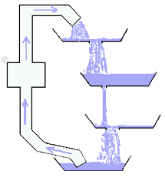
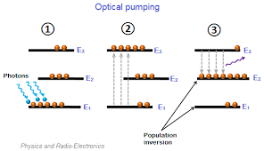
Population Inversion

Slide 14
Metastable States
Metastable state is an excited state of an atom or other system with a longer lifetime than the other excited states. However, it has a shorter lifetime than the stable ground state. Atoms in the metastable state remain excited for a considerable time on the order of 10⁻⁶ to 10⁻³. During metastable state, all the parameters associated with state hold stationary values. A large number of excited atoms are accumulated in the metastable state.
The population of metastable state can exceed the population at a lower level thereby establishing population inversion in a lasing medium. The metastable electronic state of the solid gain media is same as that of an upper laser level.
It has life time more than excited state and lesser than ground state.
https://www.azooptics.com/Article.aspx?ArticleID=794, http://winnerscience.com/2011/01/09/metastable-state/

Slide 15
Einstein’s Coefficient

